Slide 1
Early Exit Rates for Point of Entry Offices and Service Coordinators
Notes:
Last question

Slide 2
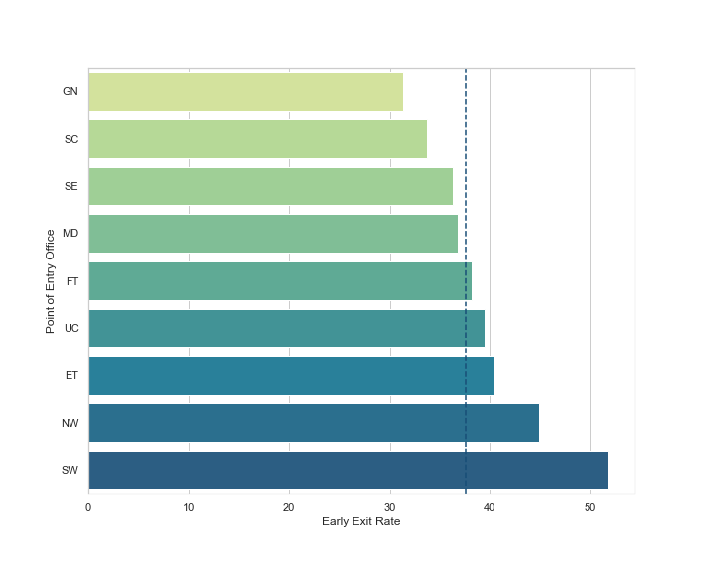
Early Exit by Point of Entry Office
Average TEIS Early Exit Rate = 37.65%
Point of Entry Office | POE Early Exit Rate | Total Service Coord. | Service Coord. with above average rate | Proportion of Service Coord. with above average rate
Southwest | 51.80% | 19 | 6 | 32%
Northwest | 44.86% | 12 | 4 | 33%
East Tennessee | 40.65% | 49 | 26 | 53%
Upper Cumberland | 39.44% | 16 | 8 | 50%
First Tennessee | 38.25% | 30 | 14 | 47%
Memphis Delta | 36.83% | 53 | 31 | 58%
Southeast | 36.33% | 24 | 15 | 63%
South Central | 33.75% | 40 | 21 | 53%
Greater Nashville | 31.39% | 50 | 29 | 58%

Slide 3
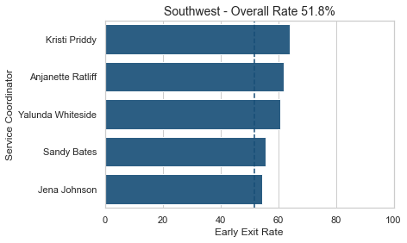
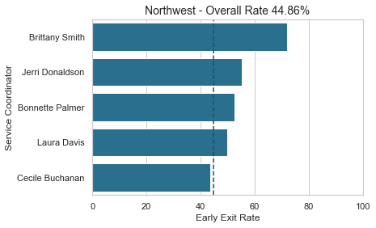
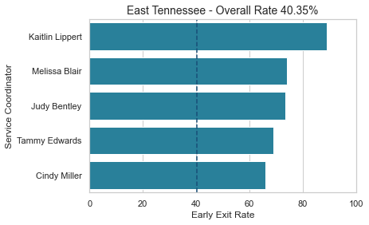
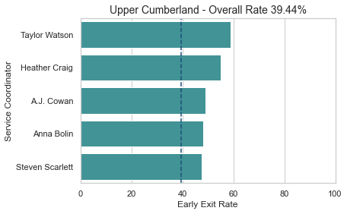
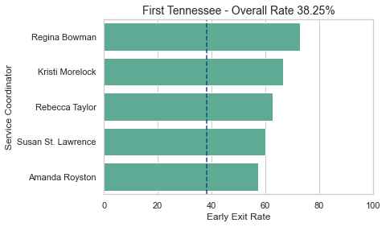
Early Exit Rate by Service Coordinator
214 / 335
18 / 25
13 / 21
112 / 203
165 / 272
128 / 244
135 / 243
75 / 150
6 / 11
107 / 245
8 / 9
43 / 73
8 / 11
17 / 23
134 / 244
52 / 78
11 / 15
29 / 59
54 / 86
29 / 42
121 / 251
6 / 10
93 / 141
132 / 277
35 / 61

Slide 4
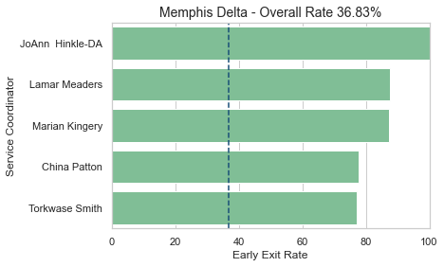
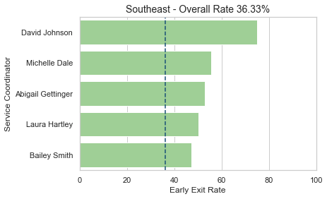
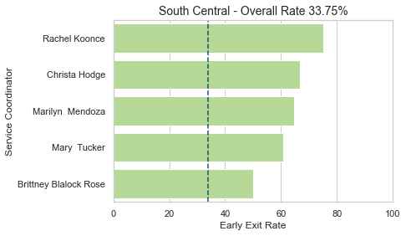
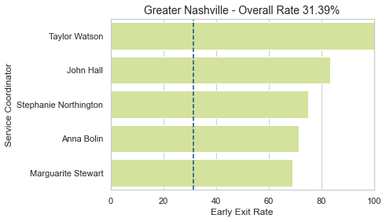
Early Exit Rate by Service Coordinator
11 / 11
27 / 36
7 / 8
5 / 9
48 / 55
9 / 17
14 / 18
64 / 127
17 / 22
46 / 97
9 / 12
4 / 4
6 / 9
5 / 6
20 / 31
3 / 4
14 / 23
5 / 7
42 / 84
9 / 13

Slide 5
Key Points for Early Exit Rates
The average TEIS Early Exit rate is 37.65%
5 Point of Entry Offices have Early Exit rates above the overall average:
Southwest
Northwest
East Tennessee
Upper Cumberland
First Tennessee
154 Service Coordinators have rates above the average for their Point of Entry Office (full list is available)
We suggest East Tennessee POE as an area to focus on
High overall Early Exit rate
High proportion of Service Coordinators whose rates fall above that average

